Slide 1
Buddhism

Slide 2
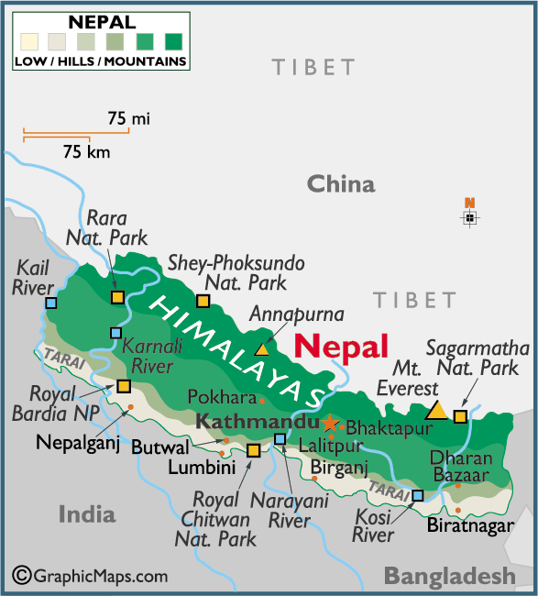
Origins of Buddhism
Started by Siddhartha Gautama
Born in Lumbini, Nepal

Slide 3
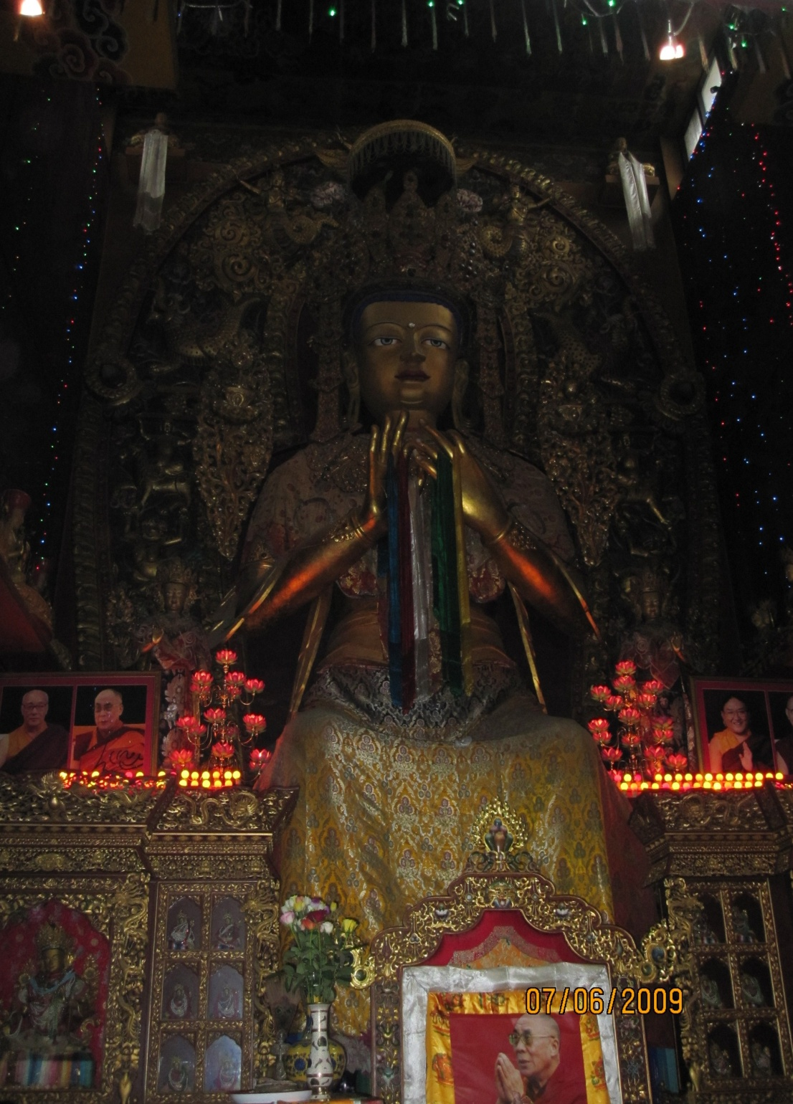
Siddhartha was a Prince
29 years old he left his home to seek understanding
Achieved enlightenment while sitting under a fig tree in India

Slide 4

Main Beliefs
Enlightenment: an individual transcends desire and suffering in order to reach nirvana

Slide 5

Main beliefs cont.
  Nirvana: a state of perfect peace, achieved by reaching enlightenment

Slide 6
Main beliefs cont.
4 Noble Truths: basic beliefs of buddhaism
Solutions to the problems in life
They need to be followed in order to attain nirvana

Slide 7
Main Beliefs cont.
8 Fold Path: a method to end worldly suffering
Outlined in the 4th Noble Truths
To follow this path is to help reach enlightenment and ultimately attain nirvana

Slide 8
Theravada Buddhism
Used meditation to train the mind
Meditation will encourage freedom of the mind from suffering
Freedom of suffering will help you reach nirvana

Slide 9
Theravada Buddhism
the earliest surviving school of Buddhism
Majority of this form of Buddhism is found in Laos, Cambodia and Sri lanka

Slide 10
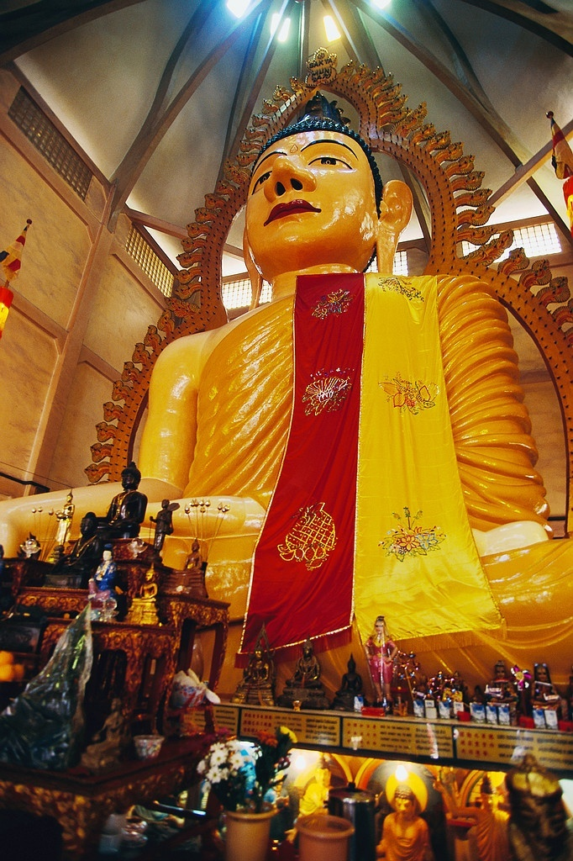
Mahayana Buddhism
To reach nirvana must practice compassion
Texts are the same as Theravada

Slide 11
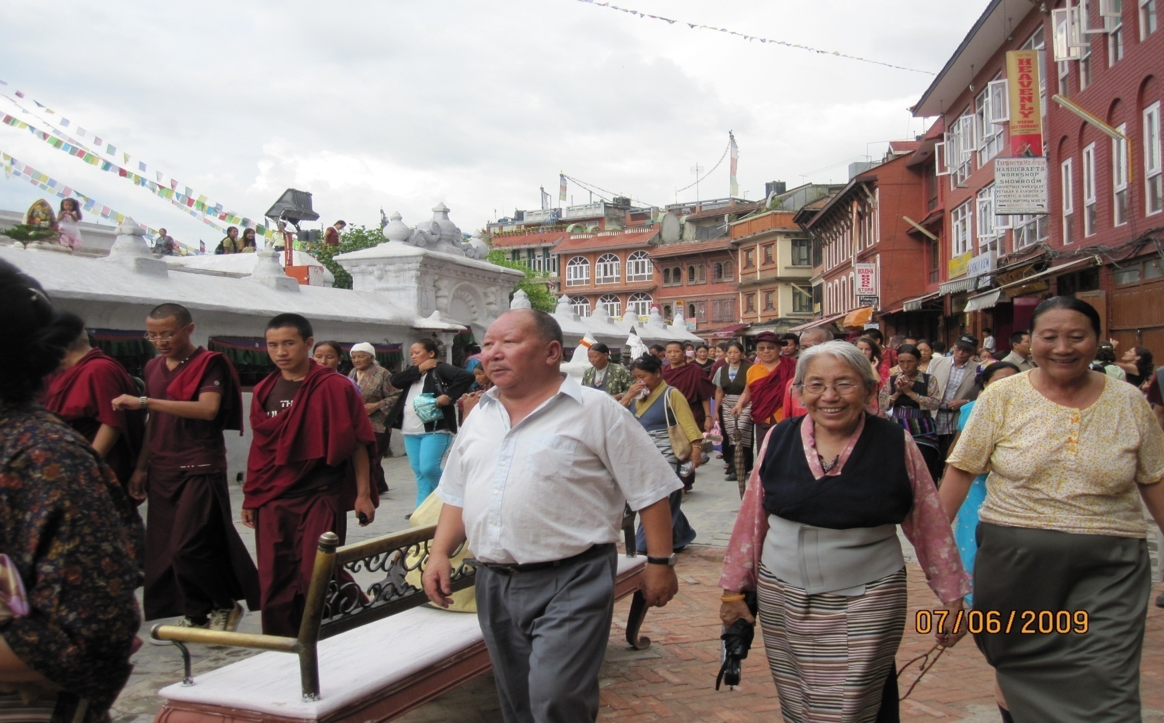
Tibetan Buddhism
Mahayana Buddhism encompasses this form

