Slide 1
Foreign Policy

Slide 2
Cotter: Unit Plan on Foreign Policy/Nepal
Subject: Government
Grade: 12
Title: Foreign Policy
Standards:
4.1 Formation and Implementation of U.S. Foreign Policy
Describe the formation and implementation of U.S. foreign policy through such questions as: How is foreign policy formed and implemented in American constitutional government?
4.2 U.S. Role in International Institutions and Affairs
Identify the roles of the United States of America in international institutions and affairs through the investigation of such questions as: What is the role of the United States in international institutions and affairs?

Slide 3
5) Objectives:
TLW understand the goals of United States foreign policy;
TLW be able to identify security and economic alliances around the globe;
TLW understand key elements that shape United States foreign policy.
6) Materials:
Internet
Magruder’s American Government 2008 Edition
WSJ - The China-India Border Brawl
U.S. Navy Report: China-India Border Dispute
Nepal News
Anticipatory Set:
YouTube Clip
Procedures
Lecture, Video, Independent & Group Practice
9) Assessment
Nepal Foreign Policy Simulation

Slide 4
Warm-Up
Foreign Policy
What is Foreign Policy?
“Policies of the federal government directed to matters beyond US borders, especially relations with other countries.” www.dictionary.babylon.com

Slide 5
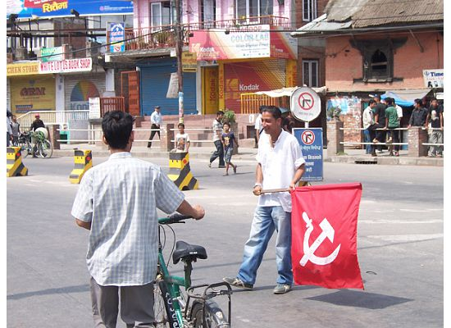
Define the following terms/concepts:
Domestic Policy | Roosevelt Corollary | Truman Doctrine/ Containment
Foreign Policy | Good Neighbor Policy | Detente
Isolationism | Open Door Policy | Foreign Aid
The Monroe Doctrine | Internationalism | Alliances

Slide 6
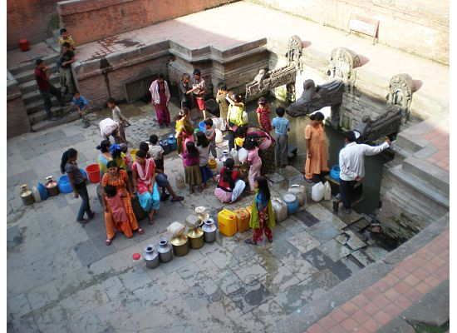
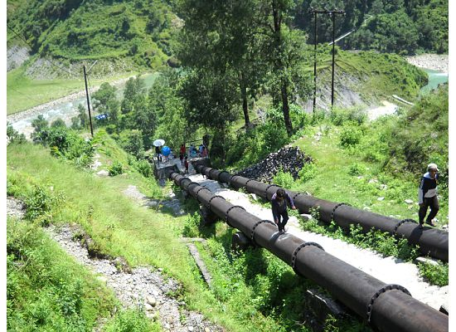
American Foreign Policy
Choose one of the following major foreign policy events and write a brief (1 paragraph) synapses of the event. Then consider the following questions:
1) What actions did the United States take in becoming involved in the
event?
2) What was the goal of the United States?
3) What was the outcome? Short term? Long term?
4) In your opinion, was the U.S. successful in achieving its goal?

Slide 7
Prior to 1945: Isolationism: The Outbreak and Aftermath of World War Two (1917-1945).
Truman : The Origins and Rise of the Cold War, The Truman Doctrine, Containment, McCarthyism, The Korean War.
Kennedy & Johnson: Cuban Missile Crisis, and U.S. Policy in Vietnam (1960-1964).
The Nixon Years: Detente with the Soviets, An Opening to China, and the End of the Vietnam War (1968-1975).
The Carter Years: The Panama Canal Treaty, Afghanistan, and the Iran Hostage Crisis (1976-1980).
The Reagan Years: Revival of a Cold War, Star Wars, Nicaragua, the Iran-Contra Scandal (1980-1988).
The Bush and Clinton Years: The End of the Cold War, the Gulf War (1988-1992), Somalia, North Korea, Haiti, Bosnia, and Kosovo (1993-2000).
Bush II & Obama: The Second Gulf War, Afghanistan, “Axis” of Evil.

Slide 8
Foreign Policy Simulation: Nepal
You will be assigned a role in the Foreign Policy Simulation: Nepal. Your job is to perform your duties in that role as best you’re able. Each role has different responsibilities, requires different skills, and is asked to achieve different outcomes. In short, you are asked to take on the role of a foreign policy maker and develop a well thought-out response to a foreign policy crises.
The simulation will take approximately three 90 minute class periods. The goal of this simulation is to provide you with a greater understanding of the process of policy making, and allow you to apply your understanding of the lessons learned from the historical survey section of the course.

Slide 9
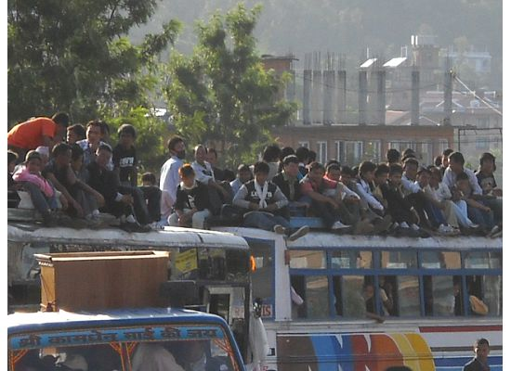
Foreign Policy Simulation: Nepal Roles
Roles
1) President 2) Presidential Advisors 3) CIA 4) Defense Department 5) State Department 6) Congress 7) United Nations 8) The Press 9) Nepal
10) India
11) China

Slide 10
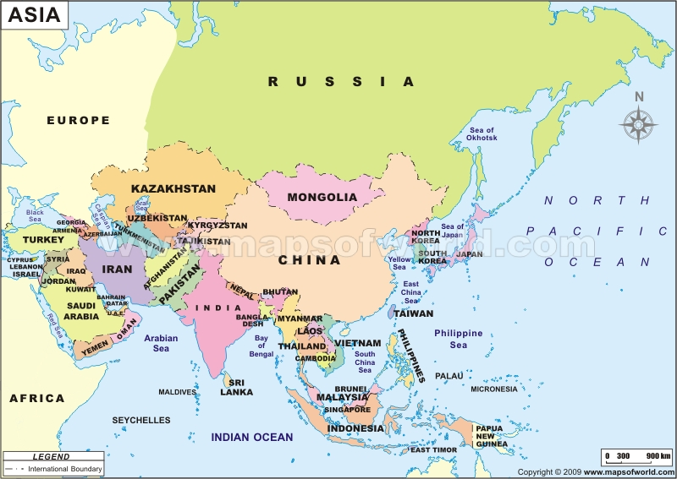

Slide 11
Foreign Policy Simulation: Nepal
OVERVIEW
Over the past several weeks, reports of alleged land encroachment by Indian border security forces have emerged from Nepalese news sources. Although the Nepal/India Kalapani border dispute has continued for some time, new reports are emerging of conflicts in other border areas. According to Republica:
“Some 2000 Nepalis from villages on Nepal-India border who have
been displaced due to alleged harassment by Indian border security
forces are running out of the meager food stuff they brought with
them. [..] The number of displaced due to harassment by India´s
border security force — Sashastra Surakshya Bal (SSB) — is
increasing. Even on Tuesday, some 250 came to Satbariya. Many are
still on the highway not knowing where to go.”
While public anger is increasing, Nepal’s fragile new democratic government has yet to take any action. Maoists and student organizations are leading increasingly violent protests against the alleged encroachment and claim that India has never truly recognized Nepal’s independence.
While the border disputes are somewhat contained at present, the general consensus is that if left unattended, they will continue to grow in violence and the region will become highly unstable. Border Unrest

Slide 12
Foreign Policy Simulation: Nepal Assignment: India
INDIA
The Indian Embassy in Katmandu denies the allegations of border encroachment and contends that any reports to the contrary are the direct result of Nepal’s other neighbor, China, attempting to rally anti-Indian sentiment in the small buffer state. Indeed, tensions between India and China continue to grow between these two fiercely competitive nations.
To begin, both nations claim rights to the Arunachal Pradesh territory, roughly 90,000 square kilometers of Indian territory that China disputes. Further, Indian officials have also accused China of supporting the Naxalites, a tenacious and growing group of Maoist insurgents that Indian Prime Minister Manmohan Singh has described as the "greatest threat to [India's] internal security." Finally, India believes that China, a growing economic and political superpower, is using the fragile post-civil war Nepal to sow its seeds of influence in the region. This is to India’s disadvantage because, among other things, China is allies with Pakistan, an arch-enemy of India and another border nation.

Slide 13
Foreign Policy Simulation: Nepal Assignment: China
CHINA
Under normal circumstances, China would support Nepal in its boarder dispute with India. However, China is has its own issues with Nepal. In short, China is concerned that Nepal’s northern boarder is too unregulated and allows easy access for Tibetan dissidents to travel to Kathmandu where they stage protests that seek to draw the world’s attention to alleged human rights violations in Tibet.
With regard to India, China claims rights to a disputed region in northeast India, the Arunachal Pradesh territory. China is also allies with India’s arch-enemy, Pakistan. China would like to have a positive relationship with the United States, but the U.S. is also struggling with Pakistan’s reluctance to fight Taliban insurgents within its borders. Further, the U.S. is on good terms with India, another large English-speaking democracy.

Slide 14
Foreign Policy Simulation: Nepal Assignment: Nepal
NEPAL
Nepal is undergoing a major transition in government.
The country's dependence on India for trade and transit routes to the south and both nations' reliance on common water resources, make Nepal's relations with India especially sensitive. Since 1950, these relations have pivoted around a Treaty of Peace and Friendship that gives India significant leverage over the kingdom on economic and security matters. Many people in Nepal advocate close ties with India, but the communist parties have resisted accommodating India's influence in the kingdom. Tapping into popular resentment against perceived Indian hegemony, "nationalists" have urged maintaining equal distance between India and China.
United States – funding, terrorist, India

Slide 15
Foreign Policy Simulation: Nepal Assignment: United States
UNITED STATES
The CIA reports suspicious insurgent movements along the Pakistan/India border.
Can’t afford to support India against China because China holds U.S. debt. India democracy, China communist
Nepal a small country, not a priority of the U.S., however maintaining a stable relationship between India and China is, as is ensuring that Nepal’s struggling new government not become a haven for terrorists.

Slide 16
Foreign Policy Simulation: Nepal Research Guide
NEPAL
Discuss recent governmental activities in Nepal and how they might affect your decision making/bargaining power.
What is your historical relationship with India ? In your answer, address the following: Treaty of Peace and Friendship; Mahakali River; Kalapani territory; ethnic Nepalese refugees from Bhutan . . .
What is your historical relationship with China?
What is your relationship with the United States? In your answer, address the following: monetary aid from the U.S.; the U.S. government’s identification of Maoists as a terrorists; former President Bush’s pledge of $20 million to aid Nepal in their fight against Maoists . . .

Slide 17
Foreign Policy Simulation: Nepal Research Guide
INDIA
What was the Sino-Indian War of 1962? What does it have to do with the Arunachal Pradesh territory? What is the basis for India’s claim to that territory?
What is the history of India’s relationship with Nepal?

