Slide 1
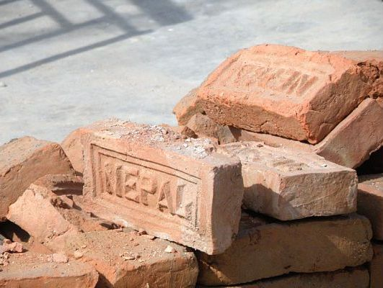
The Core Democratic Values:
The building blocks for a developing democratic nation.
By: Brian Prill

Slide 2
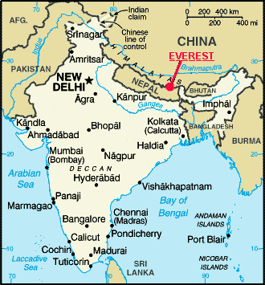
Quick Overview of Nepal
Located in South Asia, sandwiched between China and India.
Diverse society with many different ethnic groups and castes.
The world’s youngest republic and experiment in democracy.

Slide 3
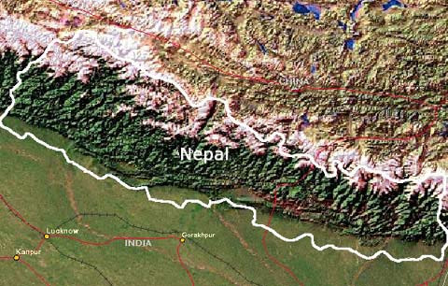
Geography
Three geographic zones
Terai: Southern fertile plains, just above sea level
Mid hills: Mountainous terrain, valleys highly populated
Himalayas: Glacier covered mountains, highest in the world.
Himalayas
Terai
Mid hills

Slide 4
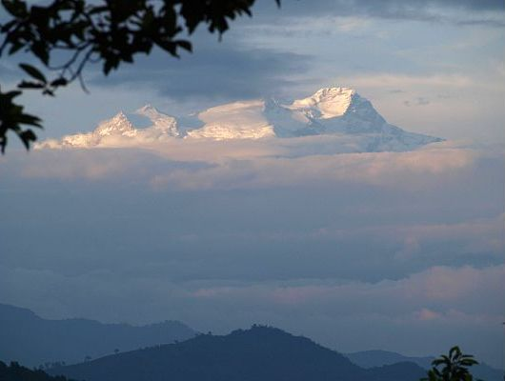
Note the height of the Himalayan mountains, many of the peaks are over 8,000 meters.

Slide 5
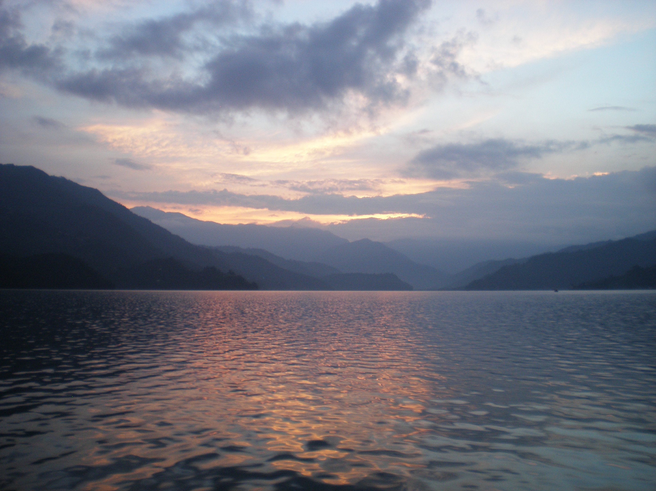
Glacial melt from the Himalayans, and torrential downpour during Monsoon season, account for massive amounts of water running through Nepal. Most of this water feeds India. There is also a huge potential for hydroelectric dams. These two factors have caused India to be very influential in Nepali politics.

Slide 6
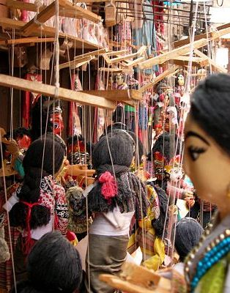
Social Structure
Over 103 different ethnic groups; many indigenous who grew into different societies because of isolation due to geography.
Caste system segments society. In the past this was very rigid, but is growing less so with each new generation.
Two ruling castes; Brahmin and Chettri
Other castes based on ethnic group or profession.

Slide 7
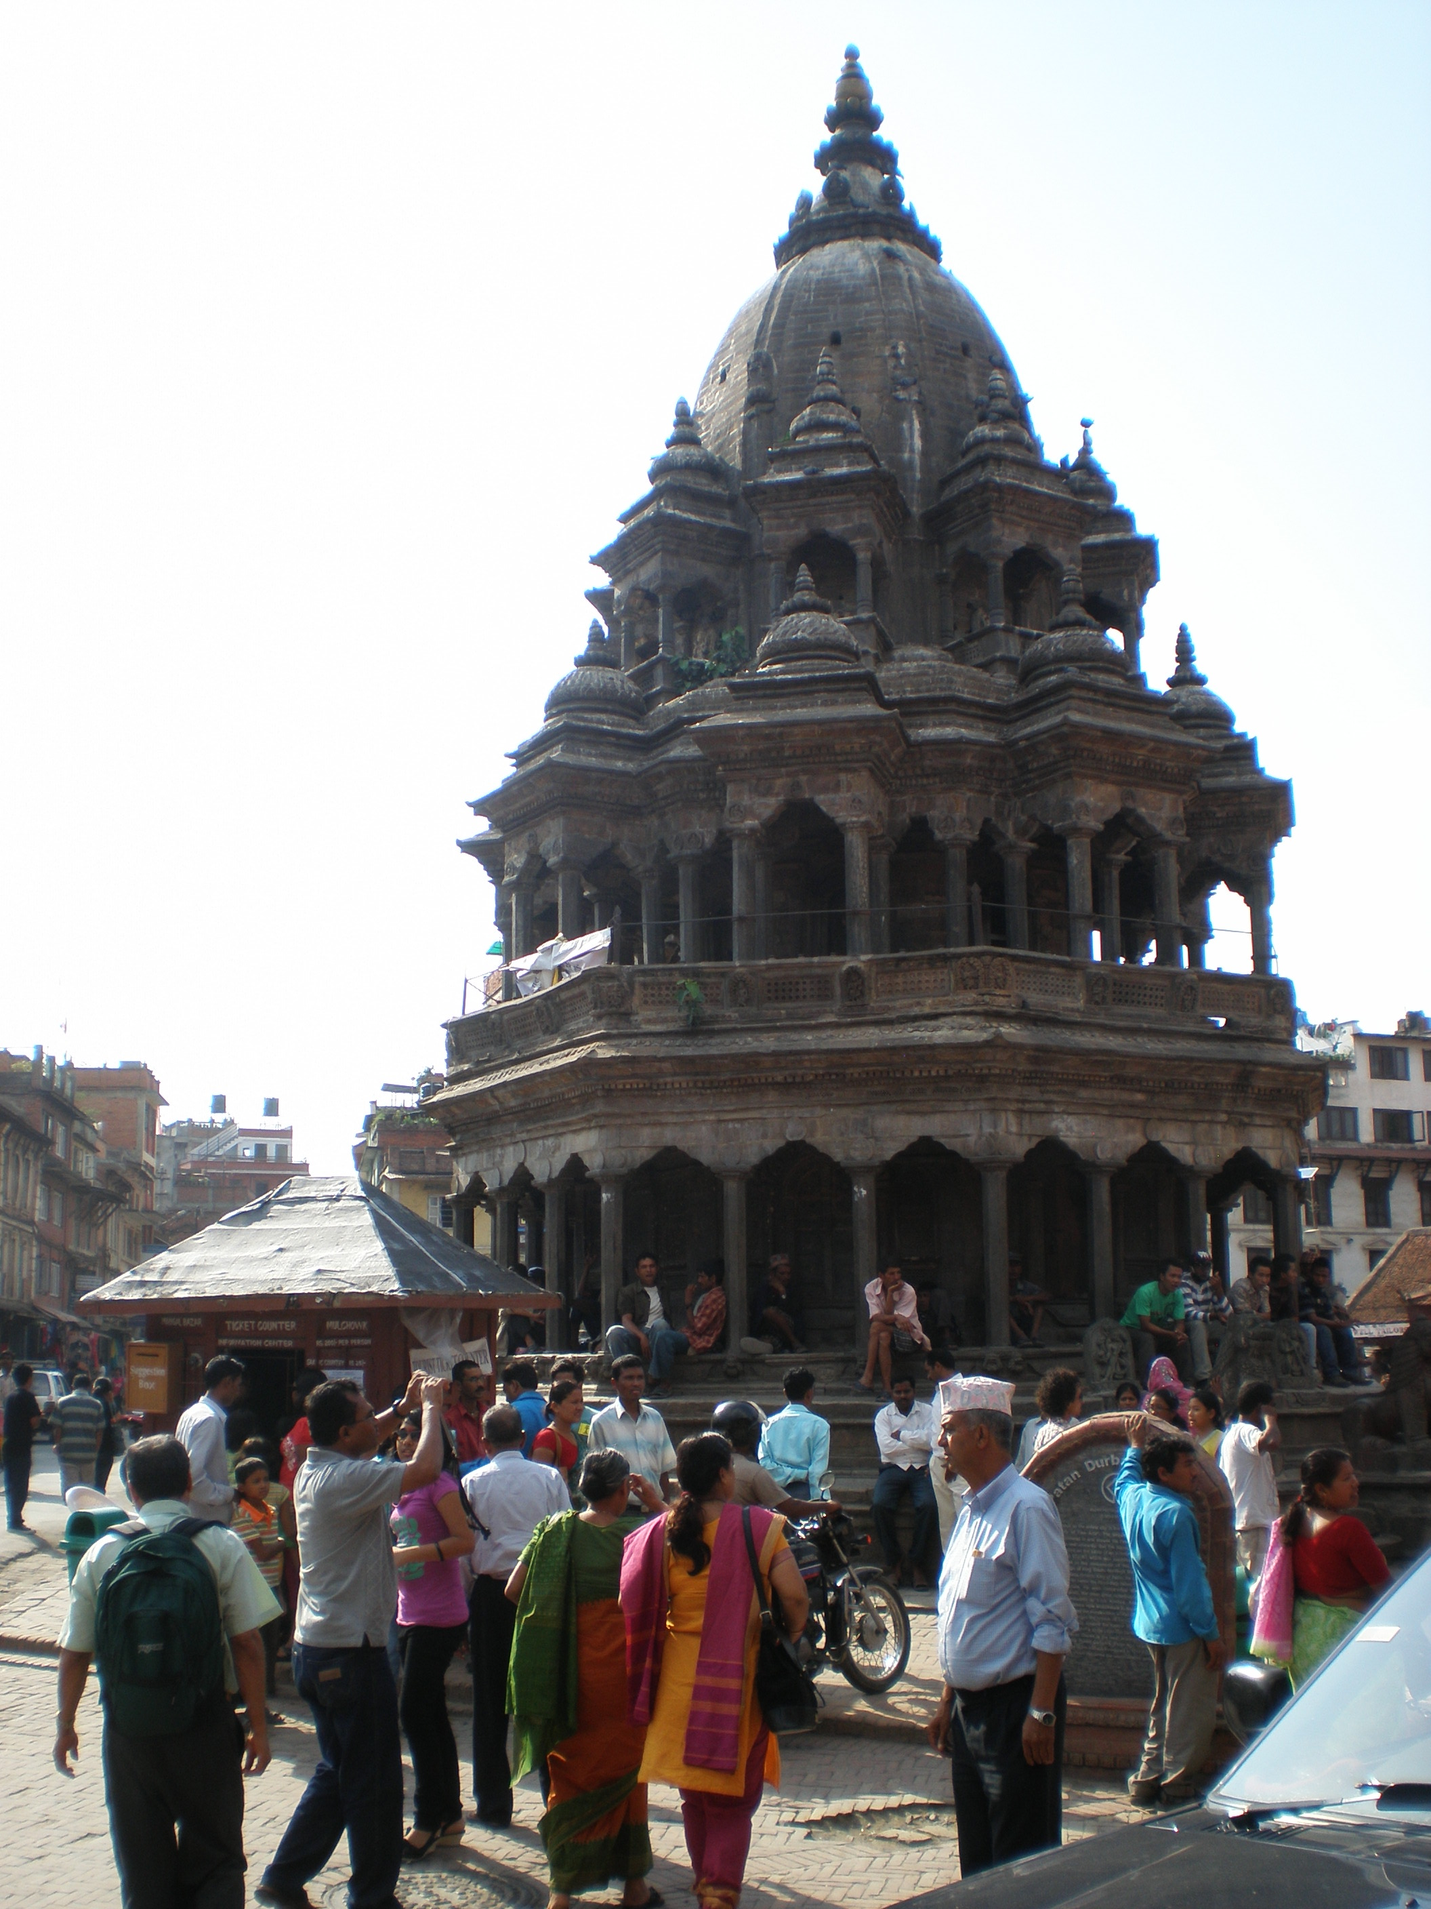
Government
Last ruling Hindu monarchy which was overthrown in 1991.
Democracy was established but seriously compromised when the Maoists lead a 10 year insurgency in an attempt to redistribute the wealth and power of the nation. In 2006, they signed a peace agreement and peacefully joined the political process.
Nepal is now functioning with an interim government that is working to rewrite the constitution and create a democratic government that is fair, just, and inclusive of all people that make up Nepali society.

Slide 8
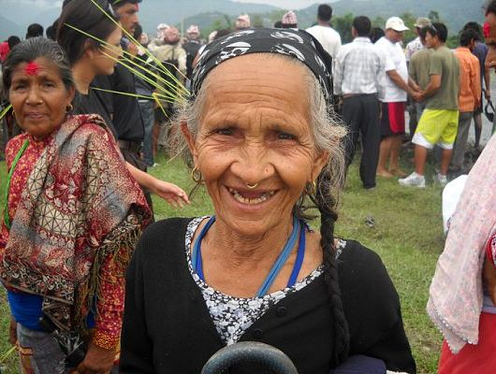
Nepal in the context of the Core Democratic Values
The following slides will show you how Nepal is functioning in terms of the Core Democratic Values or how they are facing challenges to meet the value.

Slide 9
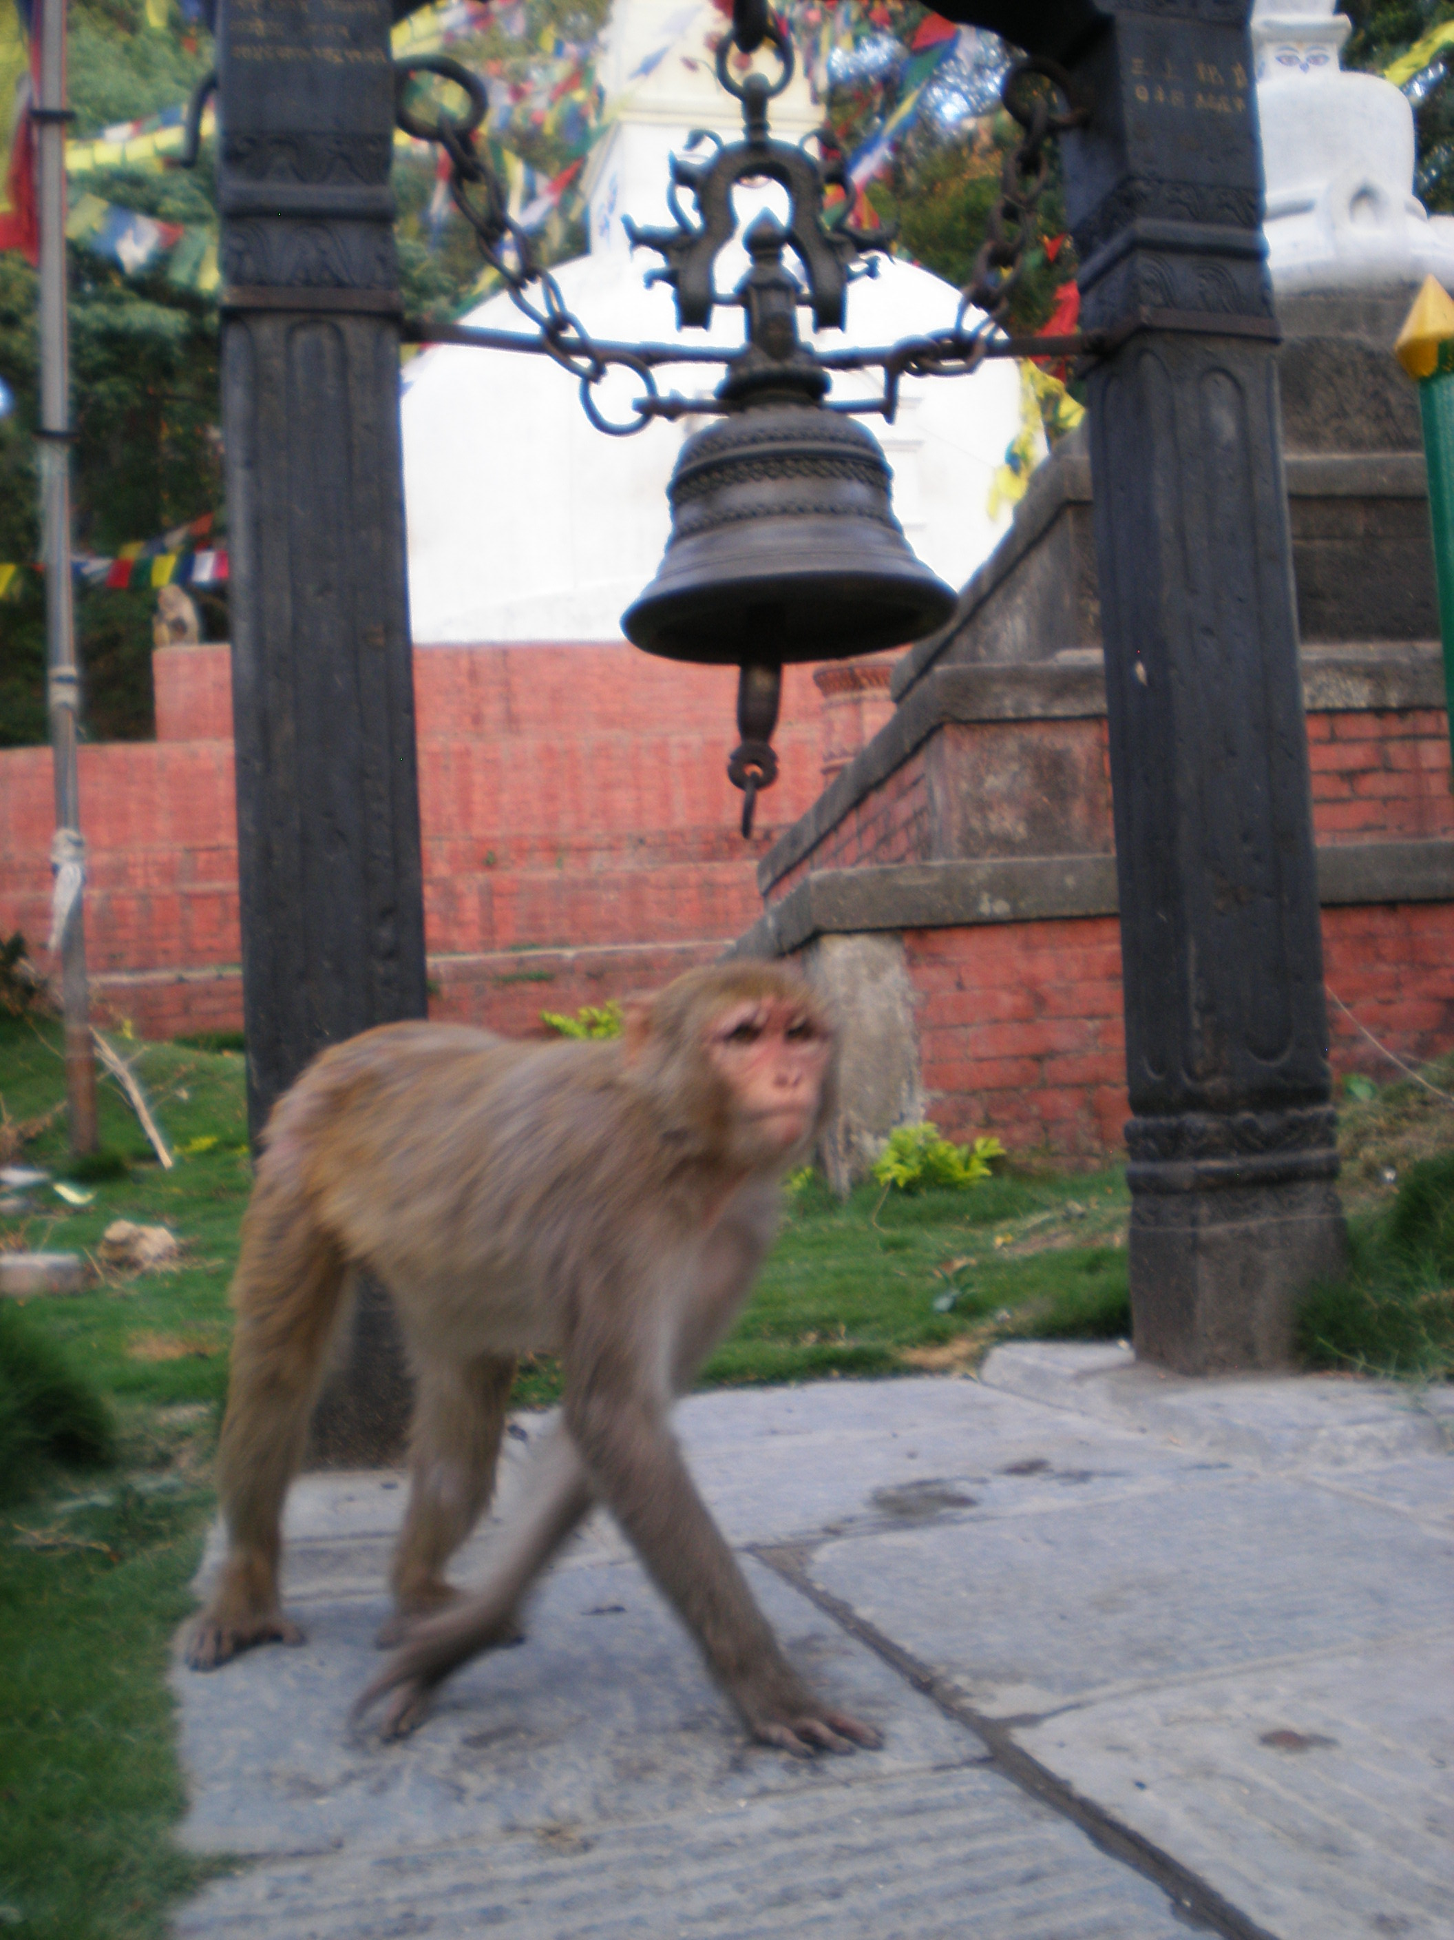
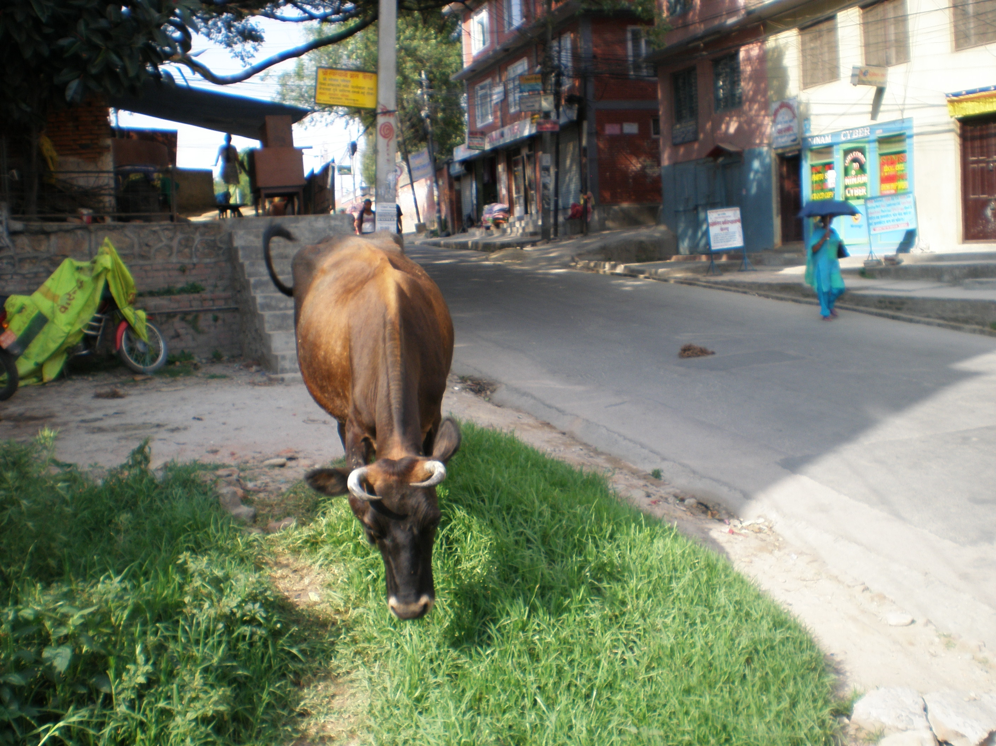
Life
Life is highly valued in Nepali life, even animals are protected.

Slide 10
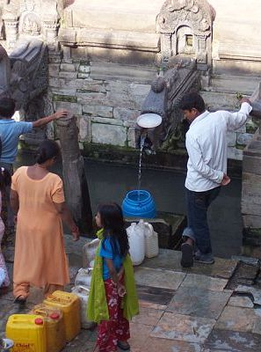
Life: continued
Clean drinking water is a prerequisite of life and one of Nepal’s greatest challenges.
For the poor, without taps in their homes, the wait for water may take hours.
In the city, people line their buckets at a communal water station, which used to be a royal bath.

Slide 11
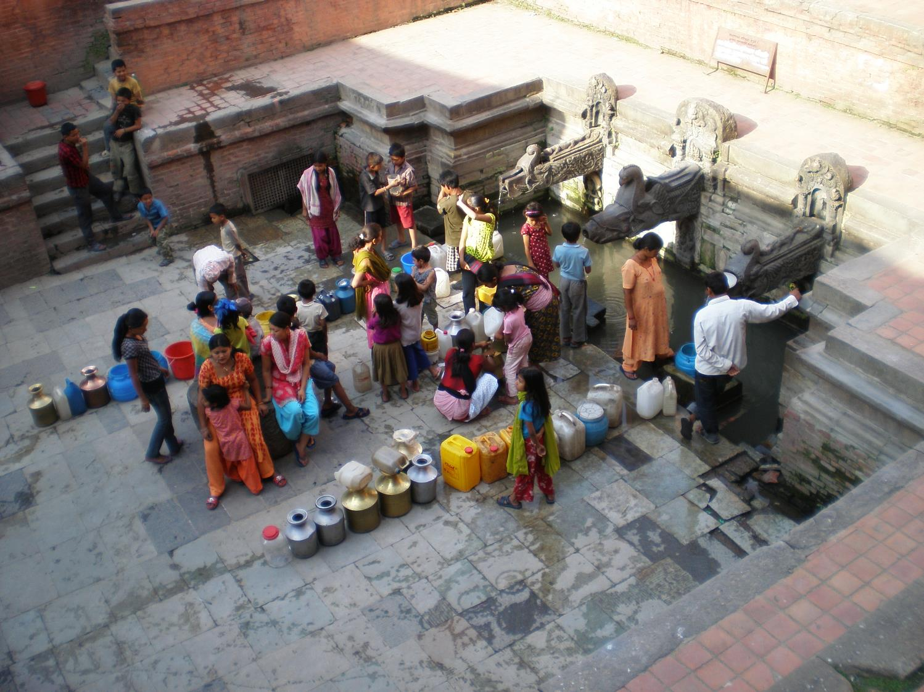

Slide 12
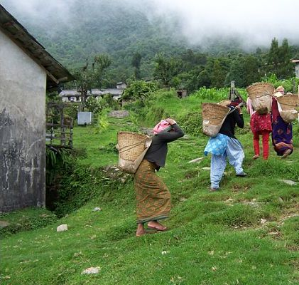
Life cont.
In the country side, especially at high elevations water presents a special challenge.
Many woman carry water from the river at the valley’s bottom to their homes at the top of the mountain, this can take hours.
Women carry heavy loads of compost.

Slide 13
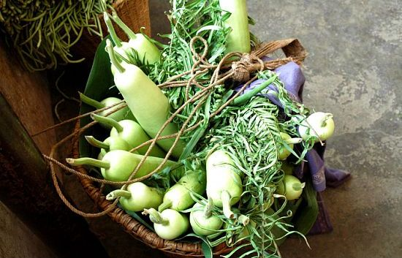
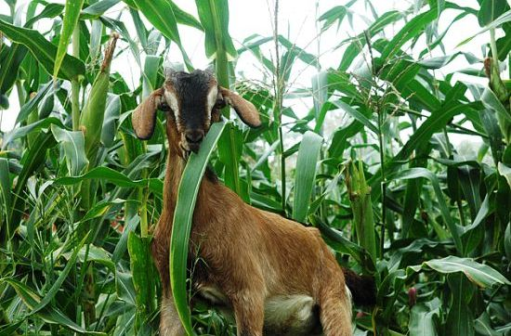
Life continued: Food
From region to region there is a great variance in food productivity.
Many people farm and also have livestock

Slide 14
Liberty: Personal Freedom Meets the Caste System
There are 103 different castes and ethnic groups that make up the mosaic of Nepal.
Brahmin, Priest Caste
Traditionally in charge of religious rites and therefore
the government as well.
You can not interchange between groups and traditionally you could not marry outside your group. This is growing less rigid with each new generation
Chettri, Warrior Caste
Often associated with the Brahmin they have helped rule Nepal
along side the Brahmin.
Gurung, Magar, Tharu, etc.
These are ethnic groups.

Slide 15
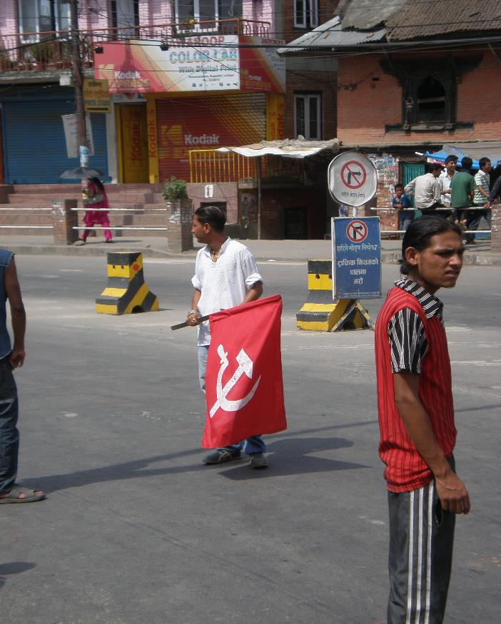
Liberty: Political Freedom
After 30 years of the Panchayat system where political parties were banned and all power lay in the hands of the monarchy, Nepal is trying democracy.
The interim government has 1 year remaining to approve new constitution.

Slide 16
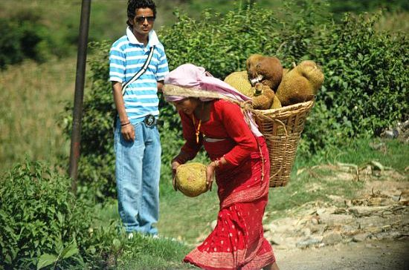
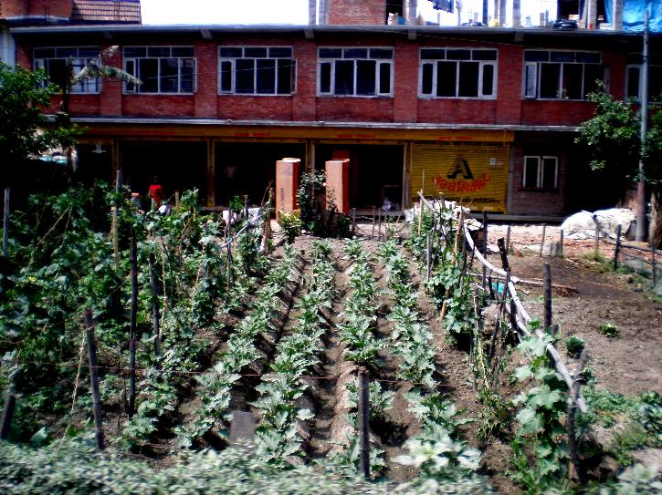
Liberty: Economic Freedom
Nepal has a strong agricultural sector, and cottage industry sector. Being landlocked makes exporting these goods challenging though.
Harvesting Jack fruit
Typical front yard

Slide 17
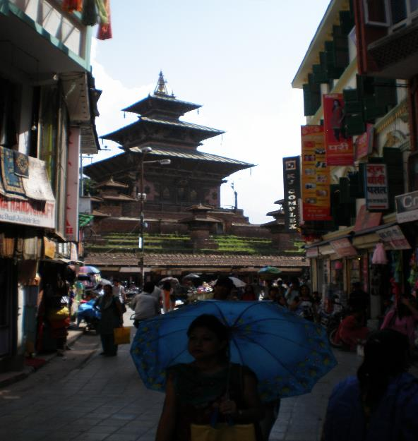
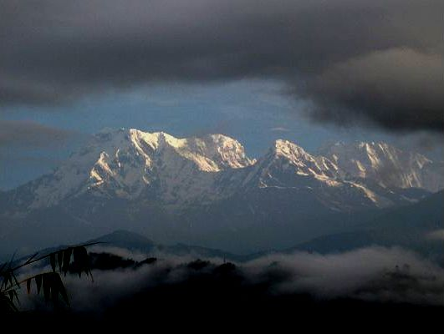
Economy cont.
Remittance (money sent home from abroad) makes up 40% of the GDP.
Another large and growing sector of the economy is tourism.
Trekking in the Himalayans is a big draw
Tourist street in Kathmandu

Slide 18
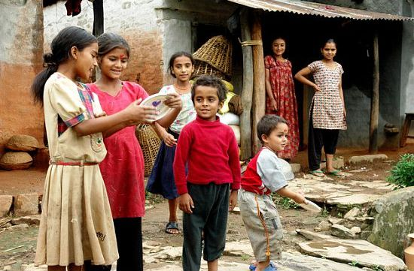
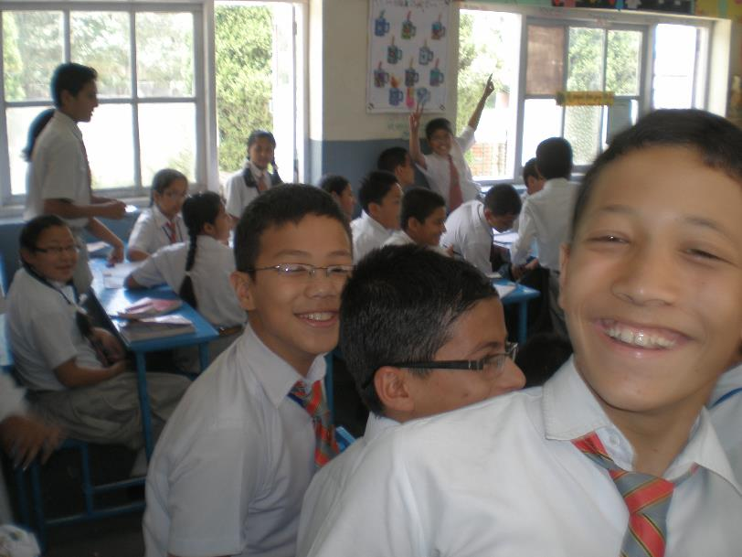
Pursuit of Happiness
Education is at the core of the Nepali drive towards happiness.
The education system has grown from 1 school for the royal family in the 60s to more than 30,000 today.

Slide 19
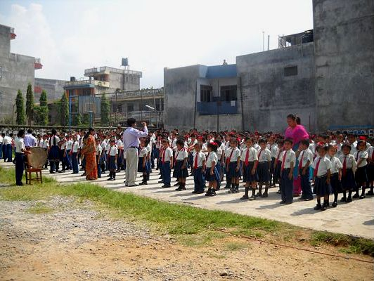
Typical school prayer recited at assembly time.
“I will pursue my education with dedication and I will excel in it. I will plant saplings and shall ensure their growth through constant care. I will constantly endeavor to remove the pain of my suffering brethren. I will work to become an enlightened citizen and make my family righteous. I promise that I will work hard with honesty to transform my country into a developed nation.”

Slide 20
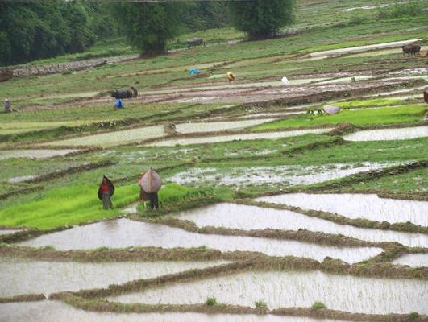
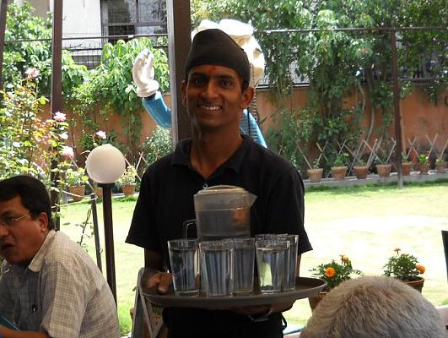
Common Good
This is a deaf and mute server, he finds employment at a restaurant that specializes by employing deaf and mute servers.
Villagers often work together during rice planting and harvesting time

Slide 21
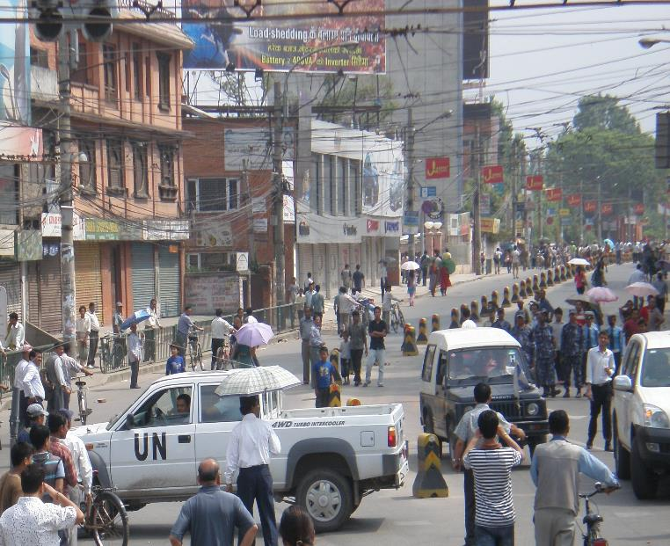
Justice
The UN came to Nepal during the Maoist insurgency. They still maintain a presence there and work to maintain peace and work as advocates for the interim government.
Justice is possibly Nepal’s weakest value. It is challenging to have law, and enforce the law, without a constitution.

Slide 22
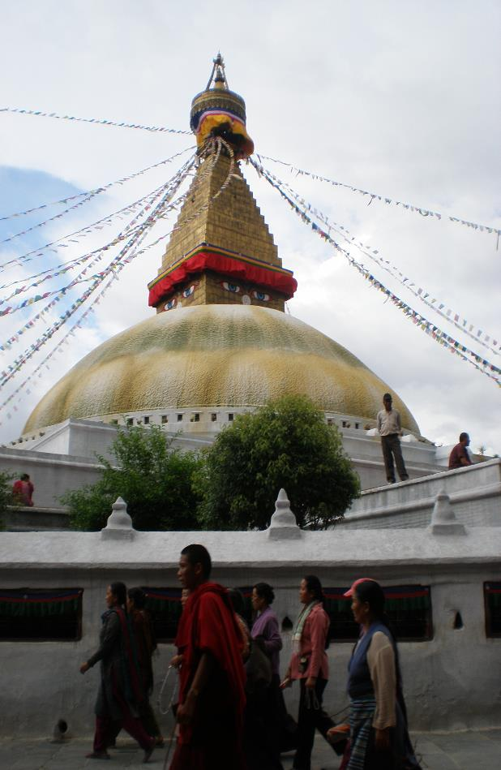
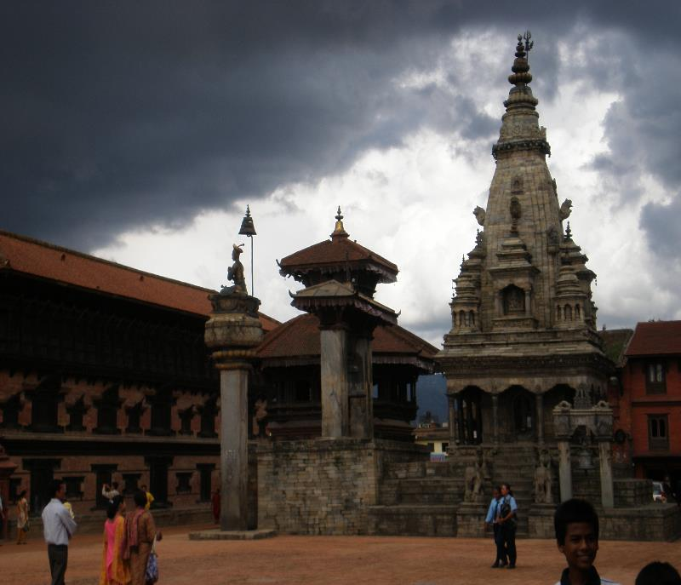
Diversity
On top of ethnic diversity, there is also religious diversity.
80% Hindu, 10% Buddhist
Small percentage of Christianity and Islam
Hindu temples and royal palace from 8th century
Budhenath: Buddhist stupa

Slide 23
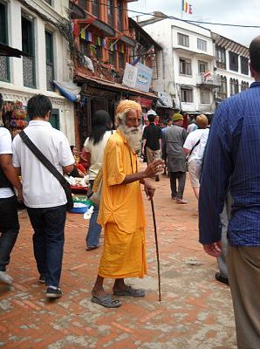
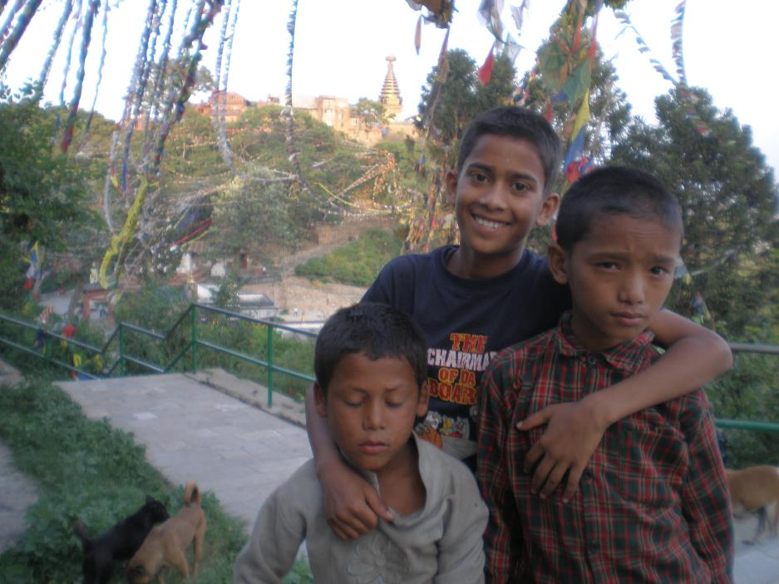
Equality
Being an incredibly diverse nation presents many challenges in terms of equality. There is also the role of men versus women to consider.

Slide 24
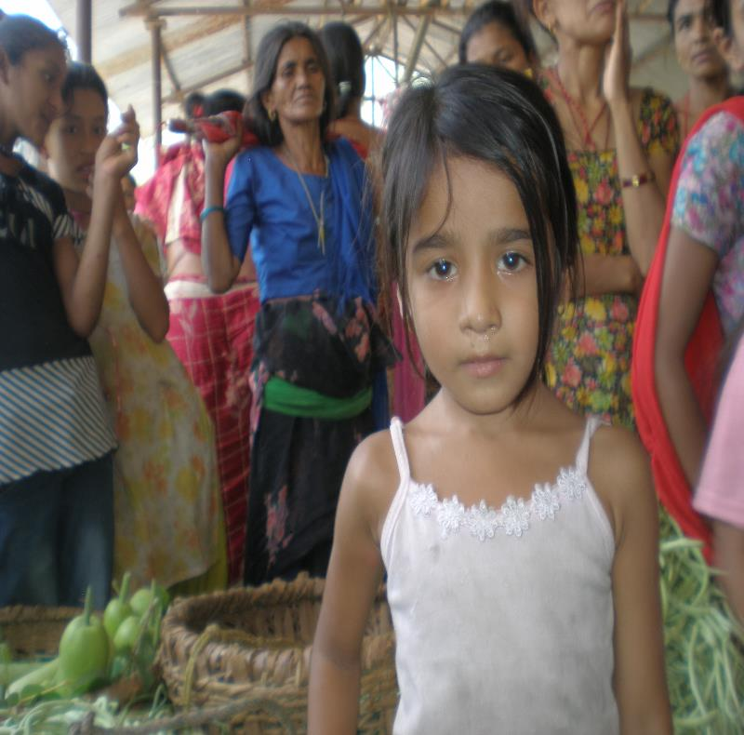
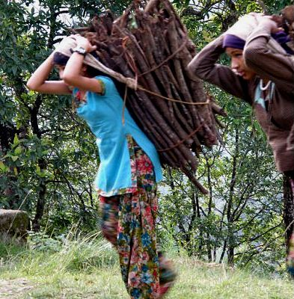
The traditional role of women is changing as girls gain an education.
Traditionally women were care takers of the home. Gathering water, cooking, cleaning, taking care of livestock, and raising the children. These task are infinitely more challenging in the developing world.
Hauling firewood anyone?

Slide 25
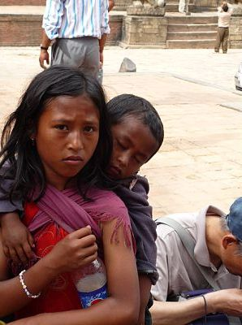
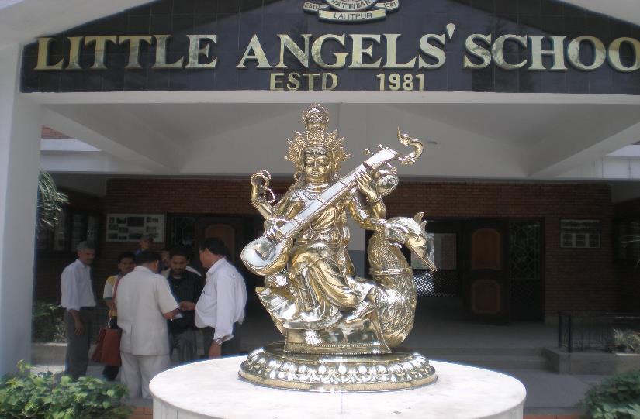
Do the poor living on the streets have the same opportunities as someone born into wealth attending a private school?

Slide 26
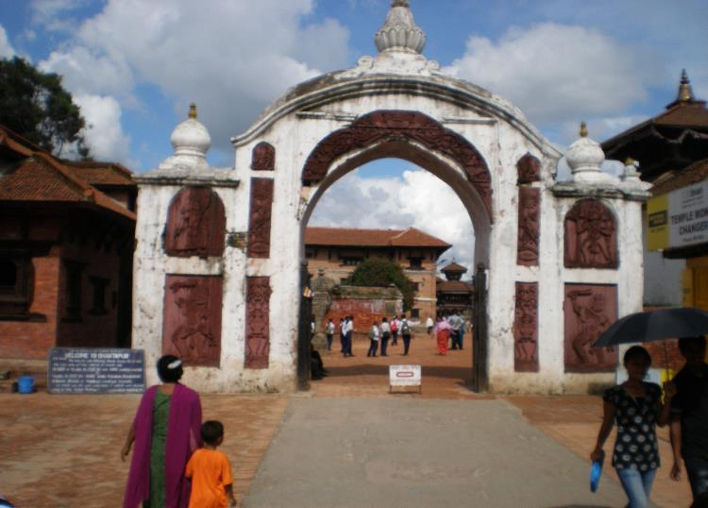
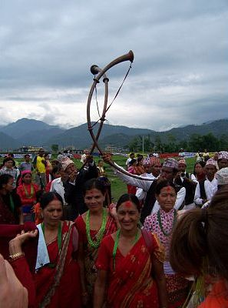
Popular Sovereignty
Quota system of interim government is attempting to bring all groups to the table to write new constitution.
240 seats from direct elections
335 seats from proposal elections broken down as;
43% Untouchable caste/ethnic group, 33% women, 20% from Southern Terai region, 4% from remote regions.
Nepal is diverse both ethnically and geographically. Therefore it is no surprise that making everyone’s voice heard is a large challenge.

Slide 27
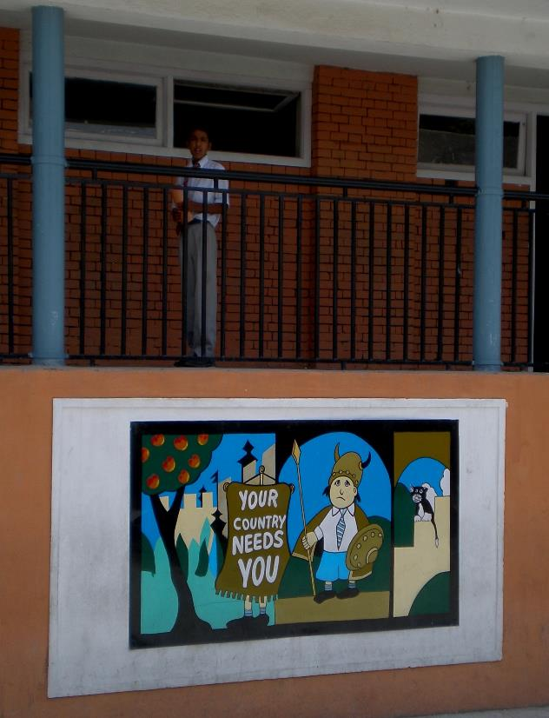
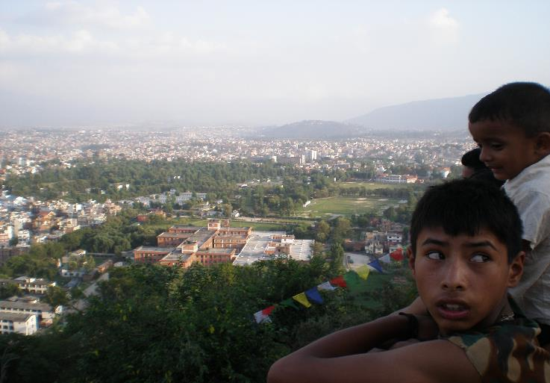
Patriotism
Nepal has never been taken over by a foreign power.
One of Nepal’s greatest challenges is called “Brain Drain.”
Well educated individuals leave the country for better economic opportunities living abroad.
Mural at a private school

Slide 28
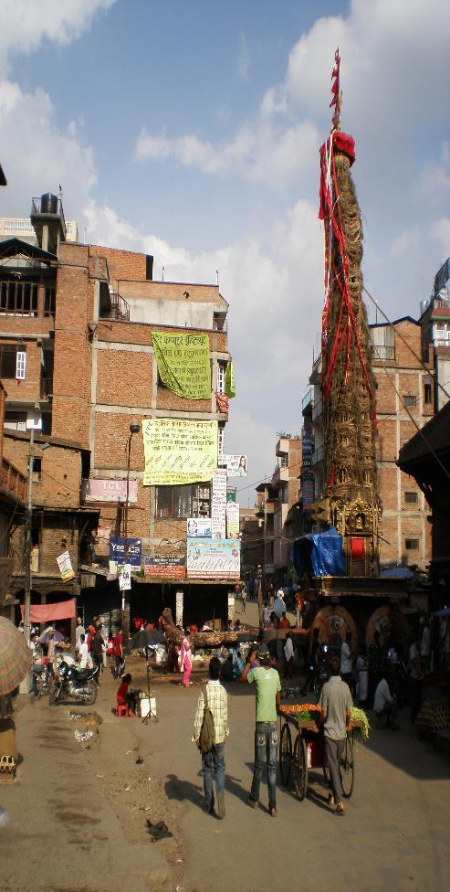
Conclusion and Significance
Nepal is a developing nation, and they are developing incredibly fast.
We need to aid and support that growth in a positive manner.
At the governmental level as well as citizen level, we can raise funds to help Nepal develop and grow.

Slide 29
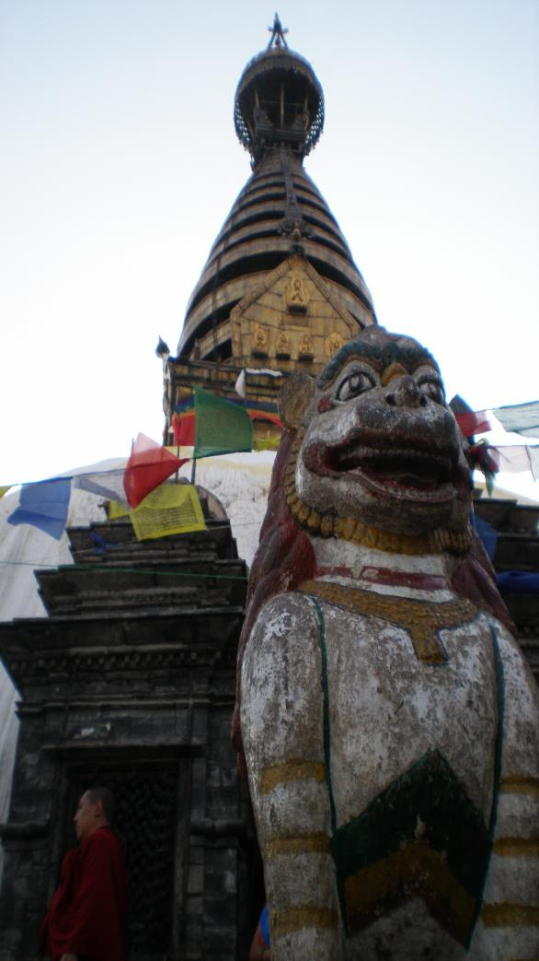
On a separate sheet of paper answer the following three questions based on your own opinion.
What are three of Nepal’s greatest strengths in meeting the core democratic values?
What are three challenges facing Nepal in terms of them meeting the core democratic values?
Why is Nepal important to the world?

