Slide 1
Nepal: Top Five Lists

Slide 2
Top 5 Basics
5. Location: Nepal is a landlocked country and is located between China and India.
4. Terrain: There are three distinct regions in Nepal. The terai (lowlands), the hills and the mountains.
3. The weather: There are four basic seasons, but one is the monsoon.
2. Human Development Index: 145 of 179.
1. Government: Nepal has been a democracy since 2006 and is moving from a unitary to federal government.

Slide 3
Top 5 Cultural Trademarks
5. Gurkha Soldiers- Part of the British Army they carry khukuri knives.
4. Dal Bhat- Rice and lentils is the national dish of Nepal.
3. Caste/Ethnic groups-There are over 100 with 90 languages spoken.
2. Religion- 80% are Hindu, 12% are Buddhist.
1. Topi and tika- national hat and mark of Nepal.

Slide 5
Top 5 Women’s Issues
5. Women in national government- Must be 33% of parliament.
4. Earnings- Women make only 60% of what men make but…
3. Water-it is a woman’s job to supply it.
2. Meals- they are the last to eat and eat alone.
1. Health- access, respiratory, uterine prolapse.

Slide 7
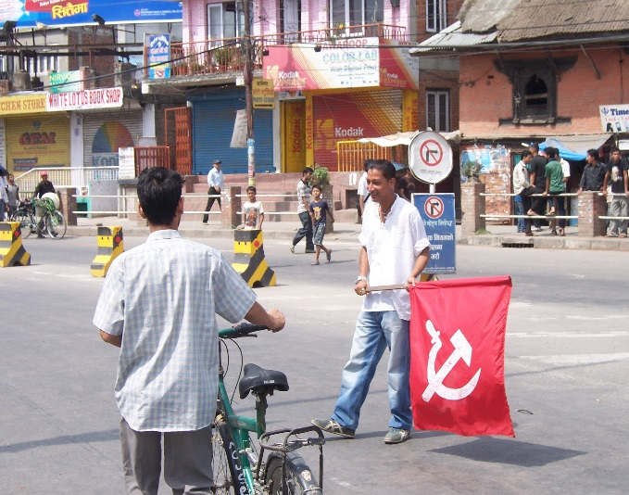
Top 5 Experiences
5. Mount Everest- it’s the top of the world.
4. Yogi- a lecture on Hinduism from an honest to goodness yogi.
3. The Bhanda- Nepali for “strike”.
2. Meeting the Prime Minister- enough said.
1. Lynne Mark- returning Peace Corps volunteer.

Slide 8
Top 5 Areas of Need
5. Water- In terms of access and cleanliness.
4. Schools- So few resources, mistakes in texts, no heat, A/C, lights.
3. Roads- Two lane roads connect major cities. Many are only three season.
2. Electricity- Before the monsoon, only 6 hours of electricity a day. Solar a possibility.
1. Sanitation- Garbage collection exists, but it is spotty, lack of cultural awareness.

Slide 10
5(0) Years Ago, or so
5. 2004- Only a few women, if any, in government.
4. 1959- No tourism, only a handful of intrepid mountain climbers.
3. 2004- Approximately 20% city population and 80% rural.
2. 1959- A 1% to 2% literacy rate, now 65%.
1. 2004- A monarchy and the only Hindu kingdom in the world.

